Slide 1
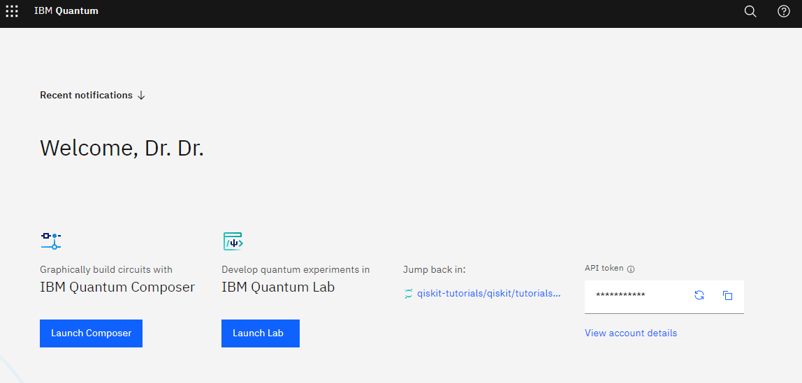
FBI
TECHNOLOGY

Slide 2

FBI
TECHNOLOGY
ENTERPRISE RESOURCES (J2EE)
SOA GOVERNANCE
nonPoliceServiceLocator.java
environment.put(Context.PROVIDER_URL,"iiop://localhost:2809");
SOA GOVERNANCE
W/sam J2EE resource page
JmsConnectionFactory cf = (JmsConnectionFactory) context.lookup(“jms/cf");

Slide 3
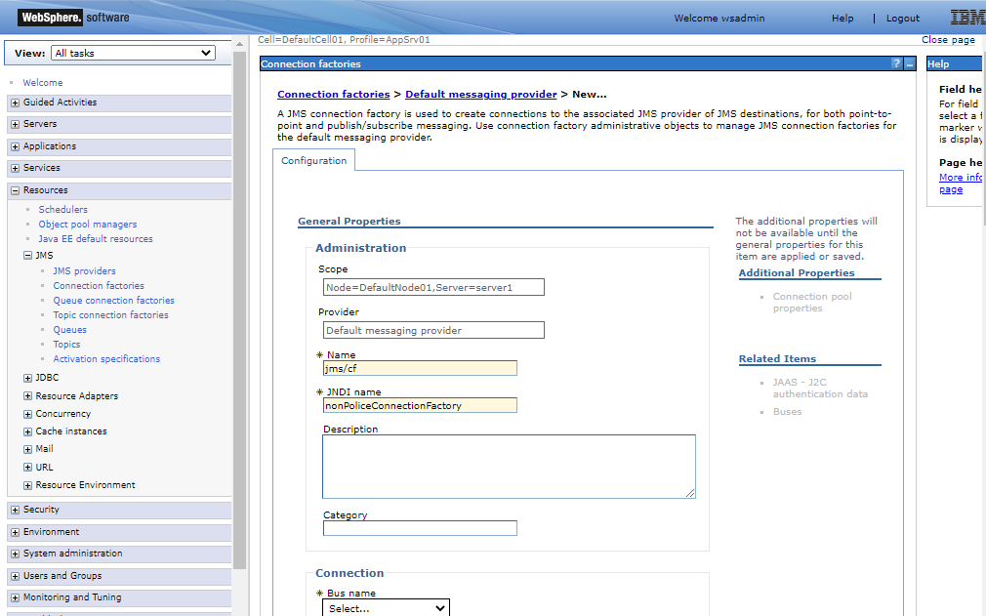
FBI
TECHNOLOGY
ENTERPRISE RESOURCES (J2EE)
SOA GOVERNANCE - W/sam J2EE resource page
nonPoliceServiceLocator

Slide 4
FBI
TECHNOLOGY

